Slide 1
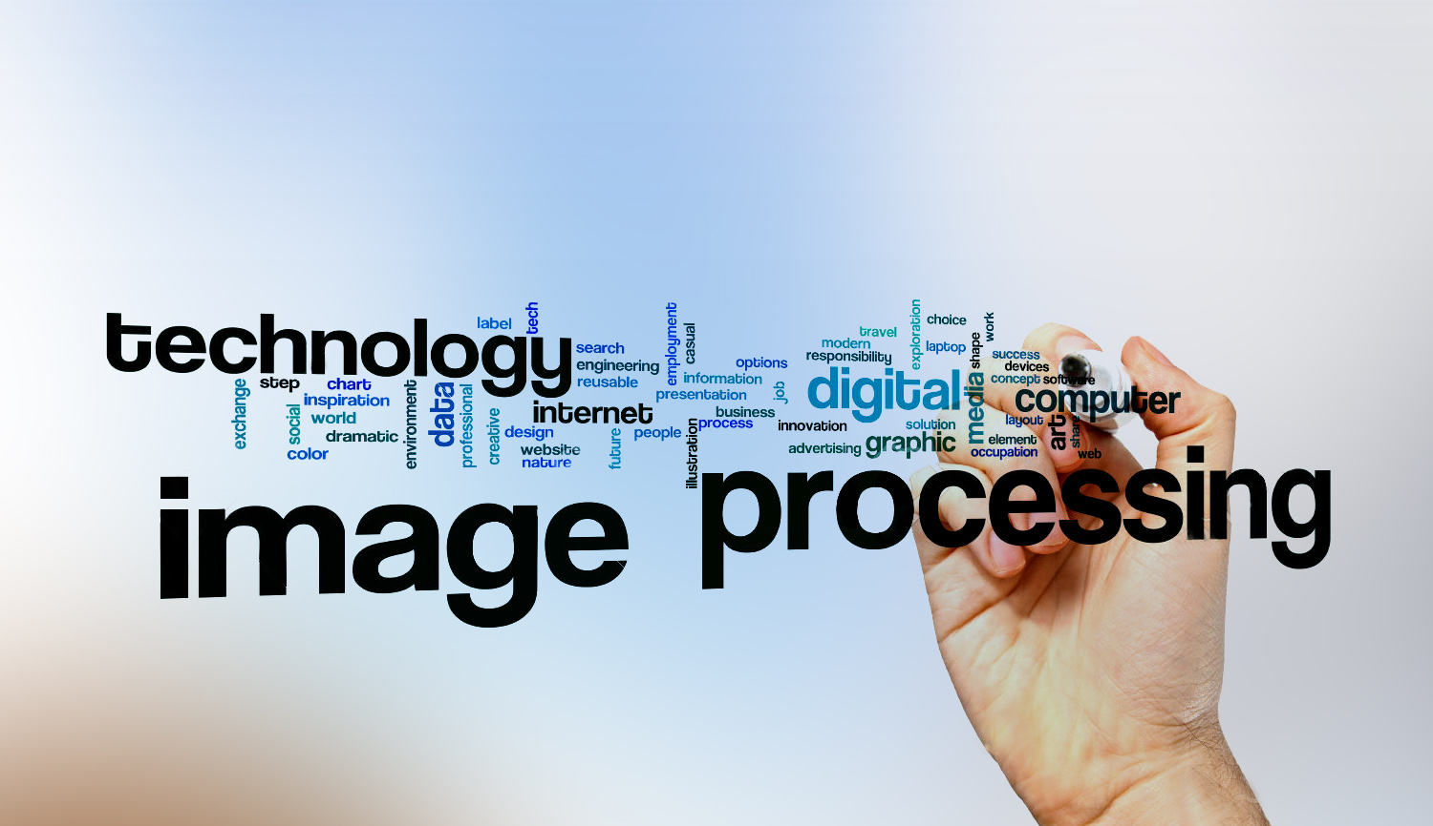
Digital Image Processing
2- DIP vs CV ?
CV
-extracting information from the input images or videos to have a proper understanding of them to predict the visual input like the human brain.
-Image processing is one of the methods that is used for computer vision along with other Machine learning techniques, CNN etc
DIP
-is mainly focused on processing the raw input images to enhance them or preparing them to do other tasks
-Image Processing is a subset of Computer Vision.

Slide 2
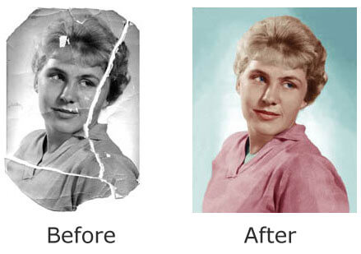
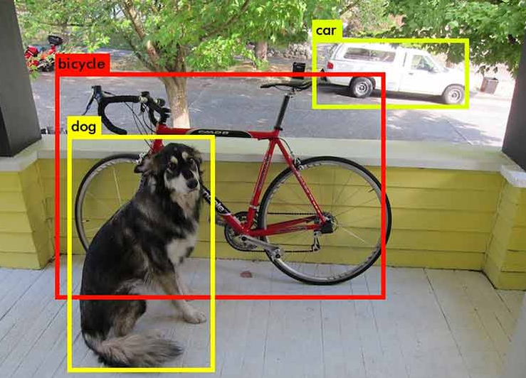
Digital Image Processing
2- DIP vs CV ?
DIP > image restoration
CV > object detection

